Slide 1
ORACLES Forecast Briefing (Aerosols)
24 September 2016

Slide 2
The Aerosol Week

Slide 3
Walvis Bay: GEOS-5 OC+BC+SO4

Slide 4
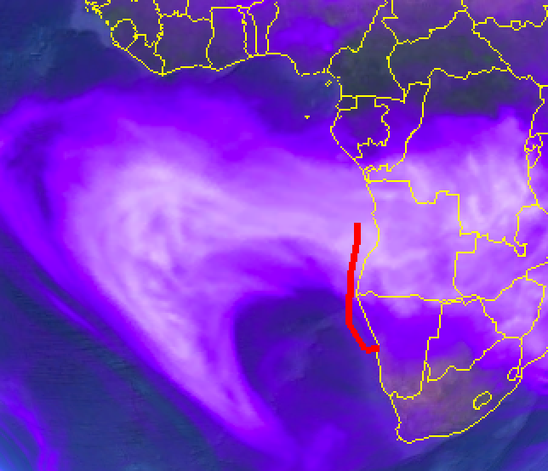
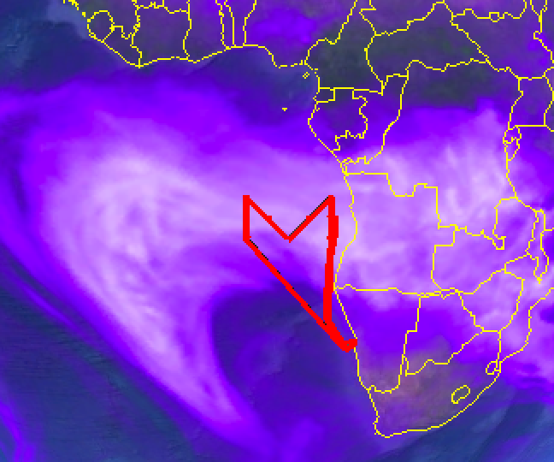
Saturday 24 September 2016
Flight Day

Slide 5
Saturday 24 Sep 2016 9Z
6:45 UTC

Slide 6
GEOS-5
WRF

Slide 7
Sunday 25 September 2016
Flight Day

Slide 8
Sunday, 25 Sep 2016 9Z

Slide 9
Sunday, 25 Sep 2016 9Z
HIGH

Slide 10
Sunday, 25 Sep 2016 9Z
MID

Slide 11
Sunday, 25 Sep 2016 9Z
LOW

Slide 13
Sunday, 25 Sep 2016 9Z

Slide 14
Sunday, 25 Sep 2016 9Z

Slide 16
PBL Height

Slide 17
GEOS-5
WRF

Slide 18
WRF NW-SE Sun 25 Sep 2016 9Z

Slide 19
monday 26 September 2016
Hard-Down Day

Slide 20
Monday, 26 Sep 2016 9z

Slide 21
Monday, 26 Sep 2016 9z
HIGH

Slide 22
Monday, 26 Sep 2016 9z
MID

Slide 23
Monday, 26 Sep 2016 9z
LOW

Slide 24
Tuesday 27 September 2016
Flight Day

Slide 25
Tuesday, 27 Sep 2016 6z

Slide 26
Tuesday, 27 Sep 2016 6z
HIGH

Slide 27
Tuesday, 27 Sep 2016 6z
MID

Slide 28
Tuesday, 27 Sep 2016 9z
LOW

Slide 29
Forecast Comparison: Tue 27 Sep 2016 9Z
GEOS-5
WRF
ECMWF

Slide 30
Tuesday 17 September 2016 9Z

Slide 32
GEOS-5
WRF

Slide 33
GEOS-5
WRF

Slide 34
GEOS-5
WRF

Slide 35
GEOS-5
WRF

